Slide 1
Neural Network for estimated line benefits

Slide 2
Overview
Problem setting + motivation (2-3)
Methodology
Process overview (1)
Optimization problem (1)
Neural network (2)
Line benefits (1)
Clustering process (1)
Results thus far
Neural network output (6)
Line benefits (2)
Future tasks (1)

Slide 3
Problem setting
Research background
Transmission expansion planning (TEP) is based on calculating Optimal Power Flow (OPF)
OPF problem is computationally heavy, especially AC formulations
Temporal aggregation for problem size reduction
Clustering for representative periods
How to find representative days for a spatially resolved system?
Ex-post clustering
Multitude of OPFs have to be solved for Transmission Expansion Planning
Multiple investment candidates (lines)
Multiple discrete investment quantities
Weather year sensitivity
Might still be computationally intensive
Literature shows that ML methods can accurately approximate OPF results very fast

Slide 4
Background: transmission expansion planning
TEP is based on calculating the demanding OPF problem
Increasing share of renewables → Rising variability in system operation
Temporal reduction techniques → Representative periods
Capture variability in system operating conditions (weather)
Accurately represent physical constraints of network
Many demanding OPFS
Computational tractability
Temporal reduction
Representative periods

Slide 5
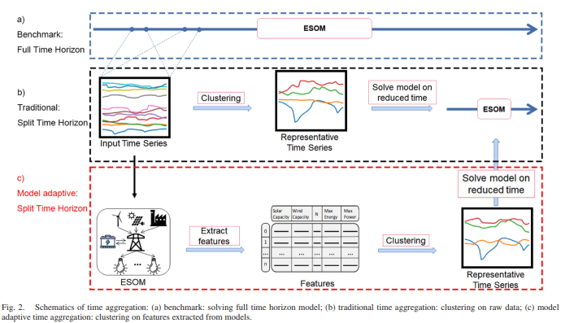
Motivation: finding representative periods
How to find representative periods for a spatially resolved system with complex interactions?
→ Ex-post clustering = use simplified model to extract features relevant for your problem and cluster on those

Slide 6
Motivation: finding representative periods
Proposed feature for clustering for TEP: Investment benefit of individual lines
Many possible candidates
Many discrete values for expansion
Weather year sensitivity
A multitude of OPFs to be solved
Replace part of the calculation with a machine-learning algorithm

Slide 7
Process overview
Benchmark:
Full time horizon
Input Data
ESOM
Traditional:
Split time horizon
Input Time Series
Clustering
Method
Representative Time Series
ESOM
Relaxed ESOM
Features
Clustering
Method
Representative Time Series
ESOM
Based in Costs:
Split time horizon
(ANN + Kmedoids)
Clustering
Method
Investment Benefit Method
Proposal:
Split time horizon
ANN: Cost Estimator
Features
(Investment benefit)
Representative Time Series
ESOM
*ESOM: Energy System Optimization Model
**ANN: Artificial Neural Network

Slide 8
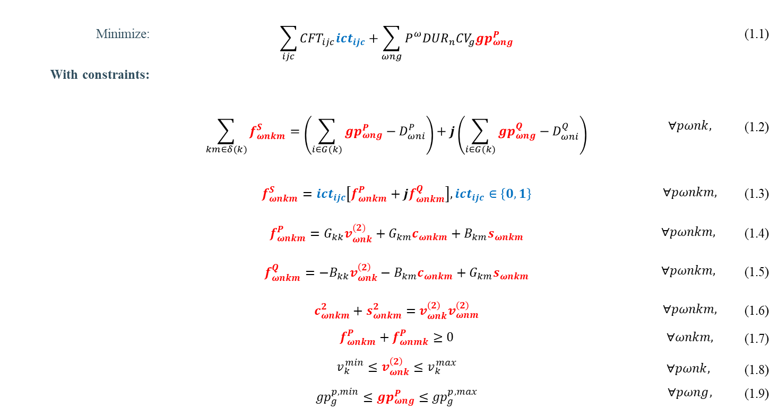
ESOM: Transmission Expansion Planning considering AC-OPF
Minimize: | $$\sum_{ijc}{{CFT}_{ijc}{ict}_{ijc}}+\sum_{ωng}{P_{}^{ω}{DUR}_{n}{CV}_{g}{gp}_{ωng}^{P}}$$ |  | (1.1)
With constraints:
 | $$\sum_{km∈δ(k)}{f_{ωnkm}^{S}}=\left(\sum_{i∈G(k)}{{gp}_{ωng}^{P}−D_{ωni}^{P}}\right)+j\left(\sum_{i∈G(k)}{{gp}_{ωng}^{Q}−D_{ωni}^{Q}}\right)$$ | $$∀pωnk,$$ | (1.2)
 | $$f_{ωnkm}^{S}={ict}_{ijc}\left[f_{ωnkm}^{P}+jf_{ωnkm}^{Q}\right],{ict}_{ijc}∈\left\{0,1\right\}$$ | $$∀pωnkm,$$ | (1.3)
 | $$f_{ωnkm}^{P}=G_{kk}v_{ωnk}^{(2)}+G_{km}c_{ωnkm}+B_{km}s_{ωnkm}$$ | $$∀pωnkm,$$ | (1.4)
 | $$f_{ωnkm}^{Q}=−B_{kk}v_{ωnk}^{\left(2\right)}−B_{km}c_{ωnkm}+G_{km}s_{ωnkm}$$ | $$∀pωnkm,$$ | (1.5)
 | $$c_{ωnkm}^{2}+s_{ωnkm}^{2}=v_{ωnk}^{\left(2\right)}v_{ωnm}^{\left(2\right)}$$ | $$∀pωnkm,$$ | (1.6)
 | $$f_{ωnkm}^{P}+f_{ωnmk}^{P}≥0$$ | $$∀ωnkm,$$ | (1.7)
 | $$v_{k}^{min}≤v_{ωnk}^{\left(2\right)}≤v_{k}^{max}$$ $${gp}_{g}^{p,min}≤{gp}_{ωng}^{P}≤{gp}_{g}^{p,max}$$ | $$∀pωnk,$$ $$∀pωng,$$ | (1.8) (1.9)
Non-convex

Slide 9
Neural Network for cost estimation
Goal
Estimate the hourly operational cost of the OPF problem
Sensitive to
time-series changes
physical network changes
Approach
Neural network works on hourly basis → Estimates one cost value
Single output (cost)
Input contains
Demand (per node)
Renewable availability factors (per technology per location)
Admittance matrix
Size of input vector quickly grows with number of buses
Demands
Availabilities
Admittance matrix
Input layer
…
…
…
Hidden layer
…
Single output
Operational cost for one hour

Slide 10
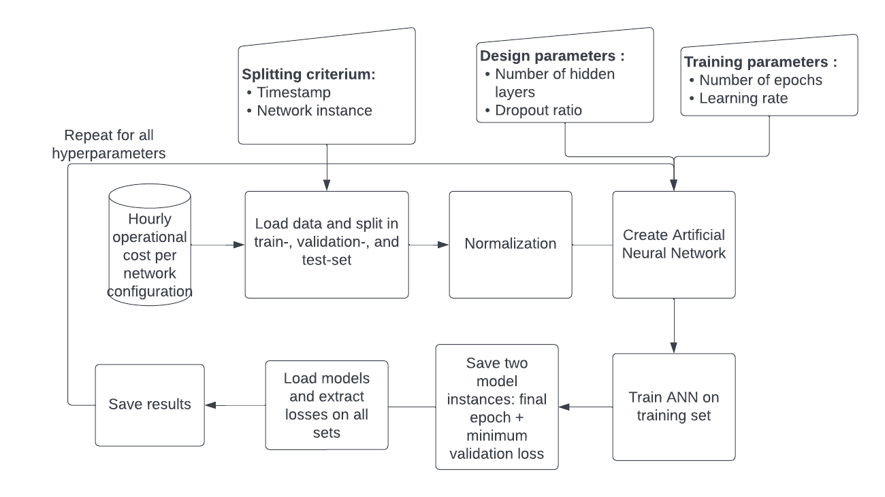
Neural network training
Goal
Train and test on a subset of desired outcomes
Achieve speedup by obtaining remaining outcomes with NN instead of optimization
Approach
Optimization performed for
1 week of each month
All individual line candidates
Split obtained dataset into training and test sets
Tune network design to obtain best result on test set

Slide 11
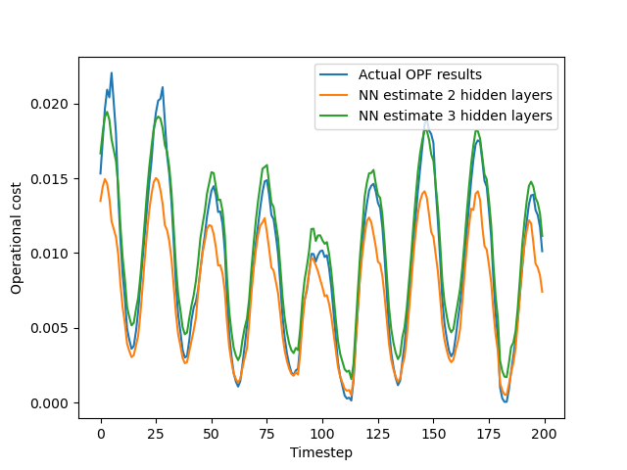
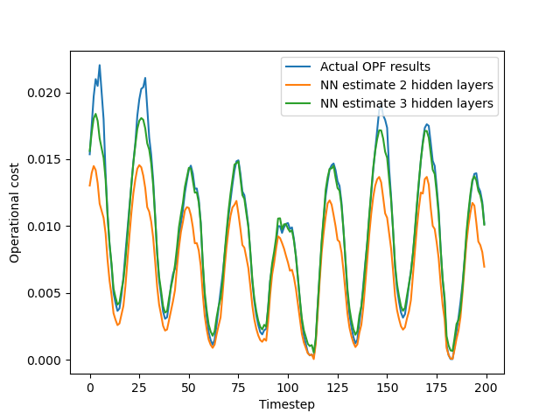
NN estimates: preliminary results
Training set
Estimation of operational cost for 24 bus system
Time dependency is reproduced, but predictions are not perfect
More complex networks (more hidden layers) seem to be performing better
Test set

Slide 12
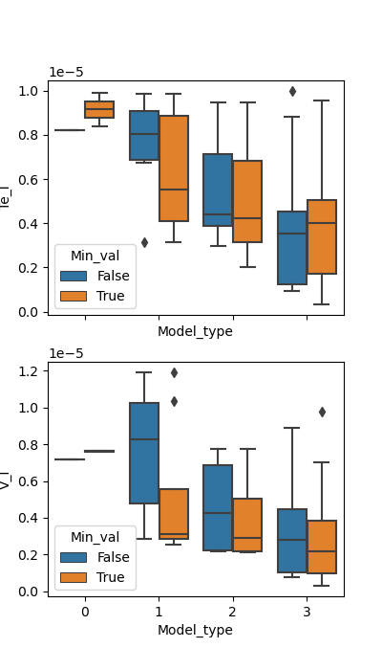
NN estimates: hyperparameter tuning
Goal
Find the optimal design and training parameters for the neural network
Approach
Train a bunch of models on the same dataset and store the loss (MSE) on the test set for all of them
Continue with model that has lowest loss
Problem
There seems to be quite some randomness

Slide 13
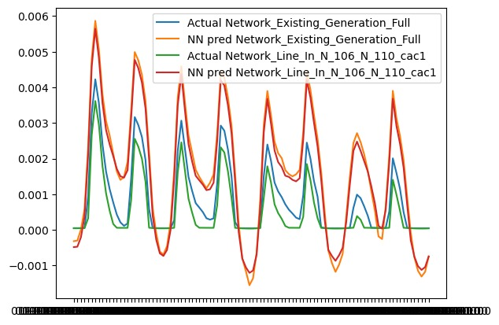
NN estimates: towards line benefits
Eventually, line benefits obtained from NN must match actual line benefits
Differences between costs from different physical networks are quite small → Predictions must be extremely accurate?
Maybe not, as long as differences are well-reproduced
→ Estimate line benefits directly?

Slide 14
NN Estimates: negative values
Custom loss function

